Slide 1
JNCIS-ENT
Layer 2 security and loop prevention

Slide 2
Spanning Tree Protocol
2
How STP works

Slide 3

Spanning Tree Mechanism
1
Switches exchange BPDUs
2
Root bridge is elected
3
Least cost path to root is calculated by each switch to determine port roles
4
Spanning Tree is fully converged
Flood
Loop Free
broadcast
X
Flood
Flood

Slide 4
Port States
In standard STP operation each port can be in 1 of 4 states
Blocking
The port drops all data packets and listens to BPDUs
The port is not used in active topology for user traffic
Listening
The port drops all data packets and listens to BPDUs
The first state of a port to be used in an active topology for user traffic
Learning
Port drops all data packets and listens to BPDUs
The switch learns MAC addresses seen from incoming frames on the port though does not forward the frames
Forwarding
The port receives and forwards data packets and sends and receives BPDUs
The final state of a port to be used in an active topology for user traffic

Slide 5
BPDU Frame Format
No 802.1Q header fields are present in an STP BPDU frame
The destination MAC address is the multicast address reserved for STP
01:80:C2:00:00:00
The source is the MAC address of the originating switchport
Destination Address
Source Address
LLC
BPDU
FCS
Length

Slide 6
BPDU Format
Protocol ID [2]
Protocol Version [1]
BPDU Type [1]
Flags [1]
Root ID [8]
Root Path Cost [4]
Bridge ID [8] =
Priority [2] +
Bridge Address [6]
Port ID [1]
Port number [1] +
Port ID [2] =
Message Age [2]
Max Age [2]
Hello Time [2]
Forward Delay [2]

Slide 7
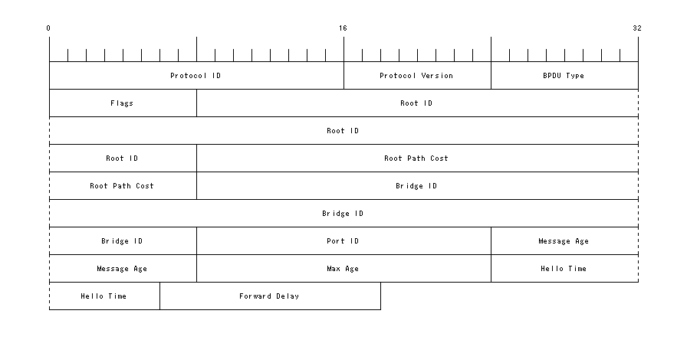
BPDU Format
BPDUs are 274 bytes in length

Slide 8
STP Convergence (1)
Configuration BPDUs are flooded by each switch
Each switch sets the Root ID field to its own BID at first, claiming itself as the root bridge
The switch with the lowest priority value wins the root bridge election
If multiple switches have the same priority value, the switch with the lowest MAC address wins
SW1 Root Bridge
SW2
SW3

Slide 9
STP Convergence (2)
Once the Root Bridge is determined, all non-root switches perform a least-cost path calculation to the Root Bridge.
This calculation determines the role of each port.
All ports on the Root are Designated Ports and in a Forwarding state
All non-root switches have 1 Root Port
The Root Port is the port closest to the Root Bridge based on the cost calculation
If multiple ports have the same cost to the Root, the port with the lower Port ID is selected as the Root Port
All non-root or designated ports are placed in Blocking state
SW1 Root Bridge
Port Speed | Cost
10 Mbps | 2,000,000
100Mbps | 200,000
1Gbps | 20,000
10Gbps | 2000
D,F
D,F
R,F
R,F
D,F
B
SW2
Designated Bridge
SW3

Slide 10
STP Convergence (3)
Once all port roles and states are determined, the spanning tree is fully converged
The maximum time for a spanning tree to converge is:
Convergence delay = 2x Forwarding Delay + Max Age
Flood
Loop Free
broadcast
X
Flood
Flood
Notes:
In this example, all traffic between left and right transits the Root, at the top.

Slide 11
STP Reconvergence
A link or switch failure triggers a Topology Change Notification (TCN) BPDU
The attached switch to the failure sends TCNs out its root port every 2 seconds until a TCN ACK is received from the Root
The Root bridge sets the Topology Change flag in its BPDUs and sends updated configuration BPDUs
When TC BPDU is received, the non-root bridges change their MAC forwarding table aging timer equal to the forwarding delay
Root
Root
TCN
TCN ACK
TCN ACK
TCN
X
X

Slide 12
STP Drawbacks
Slow convergence time
STP can take 50 seconds to converge from a topology change
The Root Bridge is responsible for communicating current tree topology
All switches must wait for the Root to dictate the topology

